Slide 1
Data Science Infrastructure
Medial EarlySign

Slide 2
Agenda
The challenges
Birdseye overview
Diving into the details:
Data
Data Repository
Training infrastructure
Analysis
Productization

Slide 3
Introduction – The Challenges

Slide 4
The Challenges – a Plethora of Different Questions
What is the probability of our patient to develop a certain condition?
Colorectal Cancer, Lung Cancer, AAA, Diabetes, CKD, ...
What is the probability that our patient complies?
gets vaccinated, takes medications, visits a GP, …
Should we ask our patient to take a blood test?
Glucose, HbA1C, Creatinine, …
Should we discharge our patient ?
From ER, Hospital ward, ICU
What would most GPs (or specialists) prescribe for our patient?
Which patients would benefit most from an action?
vaccination, home visit, life-style intervention, …
What will be the effect of treating my patient with a specific drug?
Is Drug A better than Drug B for my patient?

Slide 5

AI On Retrospective Medical Data
Data is temporal, yet highly irregular
Need to create features that capture dynamics
Some highly categorical signals
Diagnoses, Procedures, Medications
100k and more dimensions
Data comprises of different types of signals
Many signals are sparse
Data is often not standardized
Data not collected in controlled environment –
It is partial and extremely noisy
Biased
Rich in spurious patterns that make generalization difficult
Sensitive to changes in health care policies

Slide 6
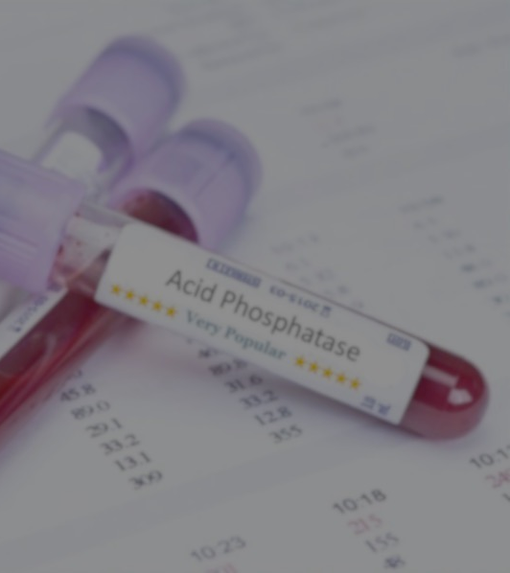
Imaging
Medical records

Slide 7
Why Build Our Own Platform ?
R, MATLAB, SciKit-Learn, TensorFlow (and extensions), etc. – all offer partial solutions.
Need | Existing Platforms
Unified medical data model | X
Configurable | ~ – Can adjust some parameters for models, but can’t configure the WHOLE process and need to do it in code
Rich and varied features set | X – Need to rewrite for each project
Analysis Tools | X – Very basic, Not matching medical analysis
Efficient in memory and speed | ~ - Training runs OK, the rest is highly not efficient.
All encompassing | X – Often start from matrix
Productization | X – Hard, need to write all the missing stuff
Easy extension | X – Often hard to make changes. Users tend to stick to the available tools
Group effort | X – Each project development is independent of others

Slide 8
Birdseye Overview

Slide 9
Elements of the Infrastructure
Data Repository
Unified
High Performance
Training Infrastructure
Deal with Time Dimension
Configurable
Matrix Generation
Training and Analysis
Productization
Single File AlgoMarkers
Easy Productization
Use within AlgoAnalyzer
On prem Sandboxes
Software Wrappers (Apps, Python)
Easy Setup (Docker)
Efficiency

Slide 10
Summary of Methodology
Model construction: Modular, C++ libraries, python APIs
Data Preparation
Model Generation
Data Model: Unified, efficient in time and memory
Validation & Analysis
Exporting
Datasets
Importing, Organization, Normalization, Ontologies
Cohort Preparation
Selecting population, Sampling, Labeling
Repository Processors
Outliers, Enrichment
Feature Generators
Moments, Trends, Embedding, Encoders
Feature Processors
Imputation, Feature Selection
Predictors
Regression, Trees, Boosting, Neural-Nets
Post-Process
Recalibration, Interpretation
Validation
Performance analysis, Bootstrapping, multiple datasets
AlgoAnalyzer
Export as AlgoMarker
Notes:
Option 1

Slide 11
Diving into the Details

Slide 12
Summary of Methodology
Model construction: Modular, C++ libraries, python APIs
Data Preparation
Model Generation
Data Model: Unified, efficient in time and memory
Validation & Analysis
Exporting
Datasets
Importing, Organization, Normalization, Ontologies
Cohort Preparation
Selecting population, Sampling, Labeling
Repository Processors
Outliers, Enrichment
Feature Generators
Moments, Trends, Embedding, Encoders
Feature Processors
Imputation, Feature Selection
Predictors
Regression, Trees, Boosting, Neural-Nets
Post-Process
Recalibration, Interpretation
Validation
Performance analysis, Bootstrapping, multiple datasets
AlgoAnalyzer
Export as AlgoMarker
Notes:
Option 1

Slide 13
Structured Medical Record
Demographics
Lab Tests
Diagnosis
Drugs
Procedures
Admissions
Not yet …
Free Text
Images, Continuous Signals
Omics

Slide 14
Data Sources
Outpatients:
MHS – Israel, 3M (>2M members currently), almost 20 years of data
THIN – UK, 16M, 18 years of data
KPNW – US, 2M (>600k members), 10 years of data
Canadian data set – 300k , 10 years
KPSC – US, Lung Cancer dataset (patients and controls)
GHS – US, design partner. Large dataset.
Inpatients:
Rambam – large Israeli hospital, >200k patients, 15 years
Mimic – public ICU dataset
eICU – large public ICU dataset

Slide 15
Data Loading Process
Quality-managed and controlled procedure:
Check consistency with pre-defined data content
Load data to staging DB
Create mapping from data elements to common terminology
Check data quality and validity using value histograms
Check consistency by time, age, gender and other covariates
Import or build required ontologies and dictionaries
Load to repository

Slide 16
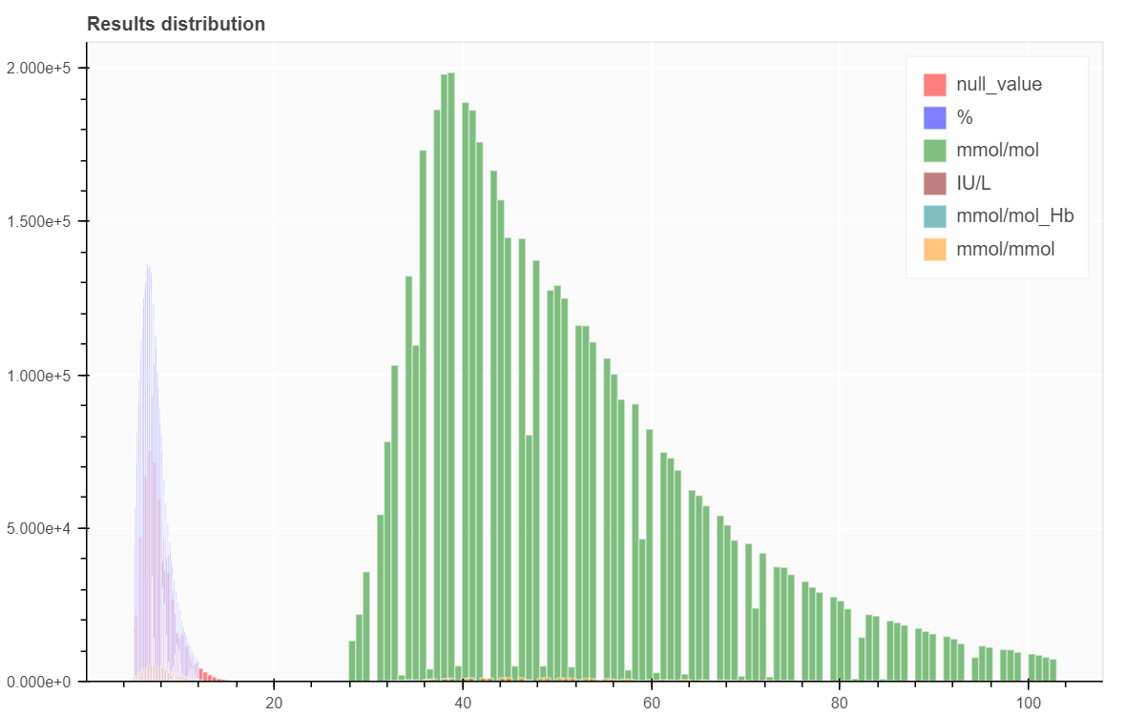
Data Loading Process - Challenges
HbA1C : histogram of results
Geographic Location
Laboratory/Blood test analyzer
Socio-economic status
Resolution of blood test results
Screening/Diagnostic Colonoscopies
Spurious dependency between resolution level and Colonoscopy finding rate

Slide 17
Summary of Methodology
Model construction: Modular, C++ libraries, python APIs
Data Preparation
Model Generation
Data Model: Unified, efficient in time and memory
Validation & Analysis
Exporting
Datasets
Importing, Organization, Normalization, Ontologies
Cohort Preparation
Selecting population, Sampling, Labeling
Repository Processors
Outliers, Enrichment
Feature Generators
Moments, Trends, Embedding, Encoders
Feature Processors
Imputation, Feature Selection
Predictors
Regression, Trees, Boosting, Neural-Nets
Post-Process
Recalibration, Interpretation
Validation
Performance analysis, Bootstrapping, multiple datasets
AlgoAnalyzer
Export as AlgoMarker
Notes:
Option 1

Slide 18
Data Model – Major Needs
Unified
Data repository
Memory Efficient
Common API for:
Demographics/Lab/Medication, etc.
Inpatient/Outpatient
Different data sources normalized at loading
Feasible with a single computer
Minimize disk access
Fast
Cluster extendable for richer data sources (Omics, Continuous Signals)
Basic Operation: get all events of a given signal per patient sorted by time
Increased number of cycles = better chance to improve performance

Slide 19
MedRepository Advantages
Extremely fast – enabler
100x faster in reading and querying data for ML training and testing.
Optimized for common queries (getting a signal per patient, accessing categorical dictionaries)
Works well on strong machines, don’t even need a large cluster:
A strong server with >64GB RAM and >8 cores is already giving good results.
Normalization (names, units, ontologies) done at loading stage
Test transferability of models to different data sets
Use different data sets in training
Categorical signals with hierarchies stored using dictionaries
A general, thin, lowermost layer with a rich set of C++/Python tools to enable complex operations – train, test, query, viewers, etc.

Slide 20
Summary of Methodology
Model construction: Modular, C++ libraries, python APIs
Data Preparation
Model Generation
Data Model: Unified, efficient in time and memory
Validation & Analysis
Exporting
Datasets
Importing, Organization, Normalization, Ontologies
Cohort Preparation
Selecting population, Sampling, Labeling
Repository Processors
Outliers, Enrichment
Feature Generators
Moments, Trends, Embedding, Encoders
Feature Processors
Imputation, Feature Selection
Predictors
Regression, Trees, Boosting, Neural-Nets
Post-Process
Recalibration, Interpretation
Validation
Performance analysis, Bootstrapping, multiple datasets
AlgoAnalyzer
Export as AlgoMarker
Notes:
Option 1

Slide 21
Cohort and Registries
A cohort represents the set of relevant individuals, with-
Time of entering and censoring
Time-line of relevant disease/condition – Registry
Accurate registries are essential for building a valid model
Data used for building a registry:
Diagnosis Codes
Almost never enough:
Under-diagnosis and under-recording is very common
Diagnosis is often too late

Slide 22
Cohort and Registries
A cohort represents the set of relevant individuals, with-
Time of entering and censoring
Time-line of relevant disease/condition – Registry
Accurate registries are essential for building a valid model
Data used for building a registry:
Diagnosis Codes
Medication
Procedure codes
Lab Tests

Slide 23
Sampling
Samples represent the set of relevant individual with time-points for learning/predictions
An individual can have more than one time-point
Each sample (individual + time-point) is assigned a label
Samples are derived from the cohort
Multiple sampling methods are possible
Sample at regular time points
Sample when certain tests are taken
Sample differently for cases and controls (beware of biases !)
Matching is often required after sampling

Slide 24
Summary of Methodology
Model construction: Modular, C++ libraries, python APIs
Data Preparation
Model Generation
Data Model: Unified, efficient in time and memory
Validation & Analysis
Exporting
Datasets
Importing, Organization, Normalization, Ontologies
Cohort Preparation
Selecting population, Sampling, Labeling
Repository Processors
Outliers, Enrichment
Feature Generators
Moments, Trends, Embedding, Encoders
Feature Processors
Imputation, Feature Selection
Predictors
Regression, Trees, Boosting, Neural-Nets
Post-Process
Recalibration, Interpretation
Validation
Performance analysis, Bootstrapping, multiple datasets
AlgoAnalyzer
Export as AlgoMarker
Notes:
Option 1

Slide 25
Repository Processors
Apply processes on signals before generating features:
Cleaners : find and clean outlying values
Panel completers : complete signals that can be calculated using other signals (e.g. MCH = Hematocrit/RBC)
Check requirements : Is a sample eligible to participate in model training/testing
Handle simultaneous reads (e.g. multiple glucose reads at the same date)
Generate virtual signals – create new signals that capture composite information and can be used to generate features

Slide 26
Summary of Methodology
Model construction: Modular, C++ libraries, python APIs
Data Preparation
Model Generation
Data Model: Unified, efficient in time and memory
Validation & Analysis
Exporting
Datasets
Importing, Organization, Normalization, Ontologies
Cohort Preparation
Selecting population, Sampling, Labeling
Repository Processors
Outliers, Enrichment
Feature Generators
Moments, Trends, Embedding, Encoders
Feature Processors
Imputation, Feature Selection
Predictors
Regression, Trees, Boosting, Neural-Nets
Post-Process
Recalibration, Interpretation
Validation
Performance analysis, Bootstrapping, multiple datasets
AlgoAnalyzer
Export as AlgoMarker
Notes:
Option 1

Slide 27
Feature Generation
Generate initial version of matrix for learning/prediction
Each line in matrix corresponds to a sample in the training/test set
A feature generator creates one or more columns in the matrix
Further processing of the matrix is possible (and sometimes required) before training or applying classifier

Slide 28
Feature Generation – Functional Features
Lab Tests are not in uniform sizes
Different number of tests per patient
Different times
Feature matrices usually need to be of a fixed size
… | Slope | Avg | Max | Last
… | Slope | Avg | Max | Last

Slide 29
Feature Generators – Many more option
Estimate lab results at pre-determined times
Demographics:
Age, Gender, Socio-economic parameters
Categorical features: Drugs, Diagnoses, Procedures
Given a categorical signal, a set in the dictionary and a time-window
Does any value in the set appear within the time window ?
How many times ?
Univariate selection, with a flavor.
Use Deep Learning to embed the large (sparse) vector of all sets into lower dimensions
Tailored features for specific areas:
Smoking, Alcohol Use, Hospitalization information

Slide 30
Summary of Methodology
Model construction: Modular, C++ libraries, python APIs
Data Preparation
Model Generation
Data Model: Unified, efficient in time and memory
Validation & Analysis
Exporting
Datasets
Importing, Organization, Normalization, Ontologies
Cohort Preparation
Selecting population, Sampling, Labeling
Repository Processors
Outliers, Enrichment
Feature Generators
Moments, Trends, Embedding, Encoders
Feature Processors
Imputation, Feature Selection
Predictors
Regression, Trees, Boosting, Neural-Nets
Post-Process
Recalibration, Interpretation
Validation
Performance analysis, Bootstrapping, multiple datasets
AlgoAnalyzer
Export as AlgoMarker
Notes:
Option 1

Slide 31
Feature Processors - Imputation
Imputing missing values -
Using stratification
Strata defined by age, gender or by other features
Imputed value per stratum may be mean, median, most common value, or a random sample from the stratum distribution
Iterative:
Use a model to predict missing value
Perform iterations of predictions to handle multiple missing values for the same sample.
Use GAN (Generative Adversarial Network) to complete features vector using given data
Perform multiple imputations to improve learning and deduce confidence intervals in predictions [Not Implemented Yet]

Slide 32
Feature Processors – Feature Selection
Some classification/prediction models perform better when non informative features are removed
Interpretability of models improves when using a smaller set of features
Productization and use in different environment is easier when requiring only a few input signals
Many methods for feature selection are implemented:
Univariate stratified correlation
MRMR
Lasso
Feature importance
Iterative – bottom up, top down (heavy in computation)

Slide 33
Summary of Methodology
Model construction: Modular, C++ libraries, python APIs
Data Preparation
Model Generation
Data Model: Unified, efficient in time and memory
Validation & Analysis
Exporting
Datasets
Importing, Organization, Normalization, Ontologies
Cohort Preparation
Selecting population, Sampling, Labeling
Repository Processors
Outliers, Enrichment
Feature Generators
Moments, Trends, Embedding, Encoders
Feature Processors
Imputation, Feature Selection
Predictors
Regression, Trees, Boosting, Neural-Nets
Post-Process
Recalibration, Interpretation
Validation
Performance analysis, Bootstrapping, multiple datasets
AlgoAnalyzer
Export as AlgoMarker
Notes:
Option 1

Slide 34
Predictors
Regression, Binary Classification, or Multi-Class Classification
A wide range of available, state of the art, models
Users can control all the models’ parameters
What people think of when saying ‘Machine Learning’, but only a part of our process …

Slide 35
Predictors
Linear/Logistic Models
Regularized - Ridge, Lasso
Generalized Additive Models
Polynomials of higher degree
Efficient implementation of Random Forest
Variants of Gradient-Boosting methods
GBM, Light-GBM, XGBoost
SVM
K Nearest Neighbors
Bayesian Additive Regression Trees (BART)
Neural Nets – in-house implementation + link to TensorFlow, Keras, etc.

Slide 36
Predictors – Meta Algorithms
Generate multi-class predictors from binary ones using one vs. all or pairwise classification
General boosting methodology
A partial Bayesian approach – Build multiple predictors for different values of specific parameters (e.g. for different age ranges)
Predictors Hierarchy – models can be used to generate features for other models

Slide 37
Summary of Methodology
Model construction: Modular, C++ libraries, python APIs
Data Preparation
Model Generation
Data Model: Unified, efficient in time and memory
Validation & Analysis
Exporting
Datasets
Importing, Organization, Normalization, Ontologies
Cohort Preparation
Selecting population, Sampling, Labeling
Repository Processors
Outliers, Enrichment
Feature Generators
Moments, Trends, Embedding, Encoders
Feature Processors
Imputation, Feature Selection
Predictors
Regression, Trees, Boosting, Neural-Nets
Post-Process
Recalibration, Interpretation
Validation
Performance analysis, Bootstrapping, multiple datasets
AlgoAnalyzer
Export as AlgoMarker
Notes:
Option 1

Slide 38
Post Processors – Apply Processes on Predictions
Recalibration
Often, good discrimination is not enough, and model calibration is also important
Training set may differ from test (real world) set in case/control probabilities
Recalibration on a different set is required
Also allows for more accurate handling of optimism in learning stage
Recalibration algorithms include –
Estimation of probability on bins: equal size, equal case-num bins.
Isotonic regression
Platt scaling

Slide 39
Post Processors – Apply Processes on Predictions
Interpretability – “But Why ?”
Explaining the black-box prediction may be necessary for adoption and for regulatory approval
An ‘explanatory’ strength and directions should be assigned per feature for each individual prediction
Challenges include –
Inter-dependency between features
Aggregating contributions into signals (or groups of features)
Several methods based on Shapley values, implemented

Slide 40
Summary of Methodology
Model construction: Modular, C++ libraries, python APIs
Data Preparation
Model Generation
Data Model: Unified, efficient in time and memory
Validation & Analysis
Exporting
Datasets
Importing, Organization, Normalization, Ontologies
Cohort Preparation
Selecting population, Sampling, Labeling
Repository Processors
Outliers, Enrichment
Feature Generators
Moments, Trends, Embedding, Encoders
Feature Processors
Imputation, Feature Selection
Predictors
Regression, Trees, Boosting, Neural-Nets
Post-Process
Recalibration, Interpretation
Validation
Performance analysis, Bootstrapping, multiple datasets
AlgoAnalyzer
Export as AlgoMarker
Notes:
Option 1

Slide 41
Performance Analysis
Analyzing models performance can be a complex task
Choose the interesting performance measures
For classification – AUC, ROC curve
For specific working point – Sensitivity, Specificity, PPV, PR, OR, etc.
For regression – Correlation, Explained Variability, etc.
Performance may depend on the time gap between prediction and event
Performance is evaluated for different time-window before event
Make sure score is not associate with diagnosis process
A sample may be excluded or even change its label when using different time-windows
Evaluation of confidence interval and statistical difference between results is achieved by bootstrapping

Slide 42
Performance Analysis
Test-set incidence sometimes does not represent the real world
Some of the parameters must be corrected
Use external incidence information, correct for age/gender distribution
Matching and Filtering of samples before analysis
Check for added value over known factors
Check for spurious patterns
Check performance on population with different characteristics
Simulations used for estimating performance for user-specific, real-world applications
Evaluate clinical and financial benefit
Kaplan-Meier estimator for survival analysis

Slide 43
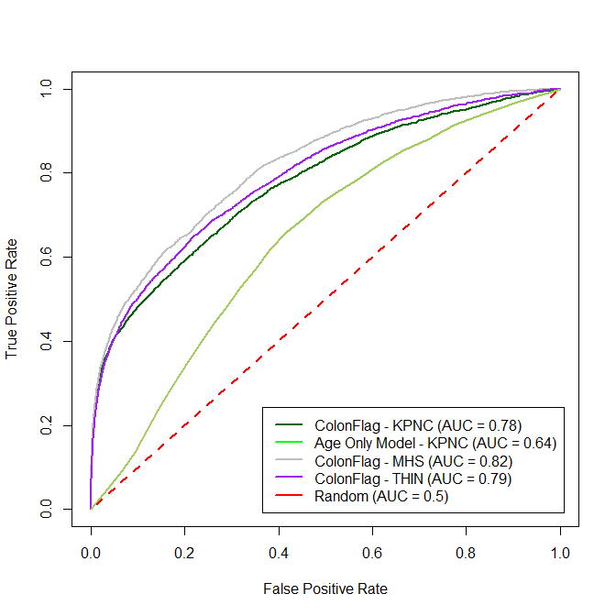
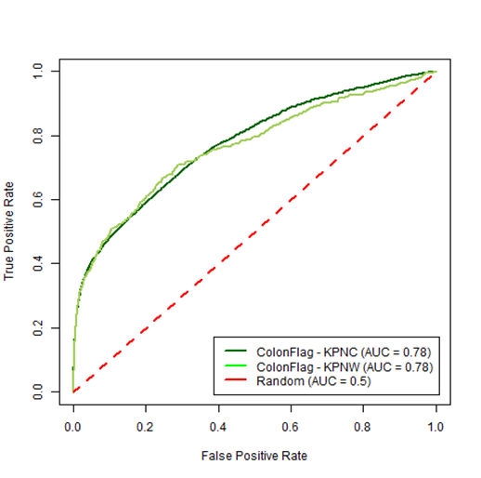
Validation – Internal and External
Check model performance on multiple internal datasets when applicable
Apply model on external datasets for additional validation
Blind validation, with labeling known only to third party, when possible
Check different population – ethnic characteristics, health-care environment, socio-economic parameters
Perform validation in a clinical trial setting
Publications

Slide 44
Performance Analysis – Model Selection
Perform grid or random search to optimize predictors’ hyper-parameters
Use cross validation for performance evaluation
Choose the performance measure(s) of interest
Possibly use multiple datasets
Other parameters of the whole process can also be optimized by systemic or random search
Feature-set optimization done using feature selector
Other elements (types of cleaning, imputation, etc.) require semi-automatic (yet fully parallelized) optimization
Performance is not the only consideration
Rare signals with small contribution should not always be added

Slide 45
External Validation and Transfer Learning
Internal
External
+
Model
Scores
Client Data
Features
Model
Retrained
Model
Trained on internal Data
Biological
No “client specific” features
Trained on large datasets
Uses the power of the Internal model
Incorporates client specific data to improve performance

Slide 46
Summary of Methodology
Model construction: Modular, C++ libraries, python APIs
Data Preparation
Model Generation
Data Model: Unified, efficient in time and memory
Validation & Analysis
Exporting
Datasets
Importing, Organization, Normalization, Ontologies
Cohort Preparation
Selecting population, Sampling, Labeling
Repository Processors
Outliers, Enrichment
Feature Generators
Moments, Trends, Embedding, Encoders
Feature Processors
Imputation, Feature Selection
Predictors
Regression, Trees, Boosting, Neural-Nets
Post-Process
Recalibration, Interpretation
Validation
Performance analysis, Bootstrapping, multiple datasets
AlgoAnalyzer
Export as AlgoMarker
Notes:
Option 1

Slide 47
Serialization – An Enabler For Productization
A ‘Model’ include all stages of the process from MedRepository signals to post-processed predictions
It is extremely important to be able to save all the complex paths a model goes through in order to get a prediction.
Thus, we need to keep –
List of required signals lists
Repository Processors, Feature Generators, Feature Processors withal their parameters
Predictor and Post Processors used with all their parameters.
For ease of use, our serialization keeps all of this into one single file
The file can be used for further training or for internal testing
The same file is used as the engine for the final product (AlgoMarker)
Serialization process is complex as it allows for backward compatibility even when objects are changed, and parameters added.

Slide 48
AlgoMarkers and the AlgoAnalyzer
AlgoAnalyzer is the product environment to use our models -
A wrapper library allows the usage of models in field with the AlgoAnalyzer.
The engine (AlgoMarker) is the serialized model file
APIs include –
Load an AlgoMarker
Push data into a virtual in-memory repository (removing after usage)
Apply model on data and report scores (raw or calibrated), eligibility information, error information, and But-Why information.
Heavily tested, stabilized, efficient
Uses the exact same model created in the training (the same serialized file).

Slide 49
Model Construction – the Complete Picture
A unified language to define and work with ML projects.
Raw Data
Semi Automated
Repository
Optional
Modeling
& Testing
Export as AlgoMarker
Cohort
Train/Test Lists
Configure:
Cleaning
Features
Selection
Normalization
Model
Sampling
Filtering
Matching
Splitting

Slide 50
Model Construction – the Code
All processes use internal (or imported) C++ libraries
Highly efficient in memory usage
Fast
Highly parallelized to improve performance on a single machine
Large, debugged and documented body of code
A large set of tools (C++ executables) wrap the basic capabilities to allow -
Loading to repositories
Model training, testing and export
Parameters optimization
Feature matrix export
Cross validation
Generation of cohorts and sample sets
Printing out models’ information
Graphical viewers for patients
More…
All of the basic capabilities and most of the tools are wrapped and have Python APIs
Exploratory projects using Jupyter notebooks
Use Python’s graphical tools
Combine with TensorFlow

Slide 51
Internal or External Sandboxes
Internal
External
Data Center
20M+ records
100M+ patient years
Data Server
Client Data
Computing Cluster
Computing Server
Installed with Medial Tools
Repository/Training/Testing/Exporting
Secured
Secured Access

Slide 52
Model construction – the Usage
Everything is highly configurable
To train a new model, no need to write code
A simple Json format configuration file defines all the stages selected for the model and their parameters
Unifying the whole process of ML on medical records to one paradigm.
Additional command-line parameters for many of the tools
Hands on example will follow …
Effortless porting to AlgoAnalyzer
A new “language” for Medical ML was created.

